Slide 1

Security+
Exam SY0-601
Chapter 19
Secure Network Design
Notes:
Gain Attention

Slide 2
Chapter 19 (Domain 3.3) Learning Objectives
Implement secure network designs.
Load balancing
Active/active
Active/passive
Schedule
Virtual IP
Persistence
Network segmentation
Virtual local area network (VLAN)
Screened subnet (previously known as demilitarized zone)
East-west traffic
Extranet
Intranet
Zero trust
Virtual private network (VPN)
Always-on
Split tunnel vs full tunnel
Remote access vs site-to-site
IPSec
SSL/TLS
HTML5
Layer 2 tunnelling protocol (L2TP)
DNS
Network access control (NAC)
Agent and agentless
Out-of-band management
Port security
Broadcast storm prevention
Bridge Protocol Data Unit (BPDU) guard
Loop prevention
Dynamic Host Configuration Protocol (DHCP) snooping
Media Access Control (MAC) filtering
Network appliances
Jump servers
Proxy servers
Forward
Reverse
Network-based intrusion detection system (NIDS)/network-based intrusion prevention system (NIPS)
Signature-based
Heuristic/behavior
Anomaly
Inline vs passive
HSM
Sensors
Collectors

Slide 3
Chapter 19 (Domain 3.3) Learning Objectives
Implement secure network designs.
Aggregators
Firewalls
Web application firewall (WAF)
NGFW
Stateless
Unified threat management (UTM)
Network address translation (NAT) gateway
Content/URL filter
Open-source vs proprietary
Hardware vs software
Appliance vs. host-based vs virtual
Access control list (ACL)
Route security
Quality of service (QoS)
Implications of IPv6
Port spanning/port mirroring
Port taps
Monitoring services
File integrity monitors

Slide 4
Load Balancing
Load balancing involves the use of devices that move loads across a set of resources in an effort not to overload individual servers.
This technique is designed to distribute the processing load over two or more systems.
It is used to help improve resource utilization and throughput but also has the added advantage of increasing the fault tolerance of the overall system since a critical process may be split across several systems.
Load balancing is often utilized for systems handling websites, high-bandwidth file transfers, and large Internet Relay Chat (IRC) networks.
Load balancing is best for stateless systems, as subsequent requests can be handled by any server, not just the one that processed the previous request.

Slide 5
Active/Active
In an active/active scheme, all the load balancers are active, sharing the load-balancing duties.
Active/active load balancing can have performance efficiencies, but it is important to watch the overall load.
If the overall load cannot be covered by N – 1 load balancers (that is, one fails), then the failure of a load balancer will lead to session interruption and traffic loss.
Without a standby passive system to recover the lost load, the system will trim the load based on capacity, dropping requests that the system lacks capacity to service.

Slide 6
Active/Passive
For high-availability solutions, having a single load balancer creates a single point of failure (SPOF).
It is common to have multiple load balancers involved in the balancing work.
In an active/passive scheme, the primary load balancer is actively doing the balancing while the secondary load balancer passively observes and is ready to step in any time the primary system fails.

Slide 7
Scheduling
Affinity
Affinity-based scheduling is designed to keep a host connected to the same server across a session.
Round Robin
Round-robin scheduling involves sending each new request to the next server in rotation.
Round-robin and weighted round-robin are scheduling algorithms used for load-balancing strategies.

Slide 8
Virtual IP
In a load balanced environment, the IP addresses for the target servers of a load balancer will not necessarily match the address associated with the router sending the traffic.
Load balancers handle this through the concept of virtual IP addresses, or virtual IPs, that allow for multiple systems to be reflected back as a single IP address.

Slide 9
Persistence
Persistence is the condition where a system connects to the same target in a load-balanced system.
This can be important for maintaining state and integrity of multiple round-trip events.
Persistence is achieved through affinity-based scheduling of server assets in load balancing.
Example: watching video stream from same media server.

Slide 10
Network Segmentation
Network segmentation is where you have configured the network devices to limit traffic access across different parts of a network.
This can be done to prevent access to sensitive machines, but also aids in network traffic management.
A group of database servers that never need direct connection to the Internet can be located on a network segment where routing rules will not allow direct connection from outside of the protected enclave.
Dividing a network into segments generally does not take more equipment, but rather is done in how the networking equipment is configured to communicate across the defined segments.
A screened subnet (DMZ) is an example of a segment, one that is accessible from the Internet, and from the internal network, but cannot be crossed directly.

Slide 11
Virtual Local Area Network (VLAN)
A virtual LAN (VLAN) is a logical implementation of a LAN and allows computers connected to different physical networks to act and communicate as if they were on the same physical network.
A VLAN has many of the same characteristic attributes as a LAN and behaves much like a physical LAN but is implemented using switches and software.
Trunking is the process of spanning a single VLAN across multiple switches.
A trunk-based connection between switches allows packets from a single VLAN to travel between switches

Slide 12
Virtual Local Area Network (VLAN)
With a combination of trunks and VLANs, network administrators can subnet a network by user functionality without regard to host location on the network or the need to re-cable machines.
VLANs are used to divide a single network into multiple subnets based on functionality.
This permits the accounting and marketing departments, for example, to share a switch because of proximity yet still have separate traffic domains.
VLANs also allow a network administrator to define a VLAN that has no users and map all of the unused ports to this VLAN, aka “black hole VLAN”.

Slide 13
Screened Subnet
The zone that is between the untrusted Internet and the trusted internal network is called the screened subnet.
This was previously known by the term demilitarized zone (DMZ)
Acts as a buffer zone between the Internet and the inner secure network.
Machines whose functionality is locked down to preserve security are commonly called hardened operating systems in the industry.
This lockdown approach needs to be applied to the machines in the screened subnet.

Slide 14
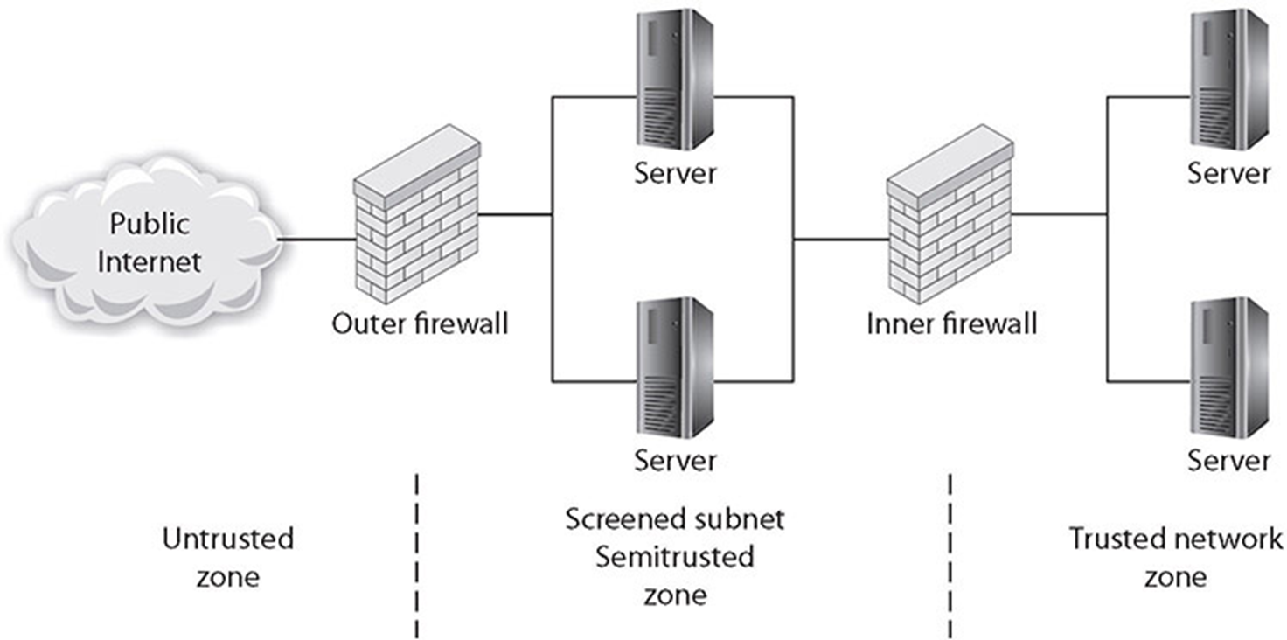
Screened Subnet

Slide 15
Screened Subnet
Many types of servers belong in the screened subnet, including web servers that are serving content to Internet users, as well as remote-access servers and external e-mail servers.
In general, any server directly accessed from the outside, untrusted Internet zone needs to be in the screened subnet.
All inner servers for internal users should not be accessible from the outside.
The idea behind the use of the screened subnet topology is to force an outside user to make at least one hop in the screened subnet before he can access information inside the trusted network.

Slide 16
Screened Subnet
If the outside user makes a request for a resource from the trusted network, such as a data element from a database via a web page, then this request needs to follow this scenario:
1. A user from the untrusted network (the Internet) requests data via a web page from a web server in the screened subnet.
2. The web server in the screened subnet requests the data from the application server, which can be in the screened subnet or in the inner, trusted network.
3. The application server requests the data from the database server in the trusted network.
4. The database server returns the data to the requesting application server.
5. The application server returns the data to the requesting web server.
6. The web server returns the data to the requesting user from the untrusted network.

Slide 17
East-West Traffic
Data flows in an enterprise can be described in patterns, such as north-south and east-west.
East-west traffic refers to network data flows within an enterprise network.
North-south traffic refers to data flowing between the enterprise network or data center and the outside of the network.
The levels of east-west traffic are important to network engineers, as the networking infrastructure must be able to sustain operational loads.

Slide 18
Extranet
An extranet is an extension of a selected portion of a company’s intranet to external partners.
This allows a business to share information with customers, suppliers, partners, and other trusted groups while using a common set of Internet protocols to facilitate operations.
Extranets can use public networks to extend their reach beyond a company’s own internal network, and some form of security, typically virtual private networking (VPN), is used to secure this channel.
The use of the term extranet implies both privacy and security. Privacy is required for many communications, and security is needed to prevent unauthorized use and events from occurring.
Proper firewall management, remote access, encryption, authentication, and secure tunnels across public networks are all methods used to ensure privacy and security for extranets.

Slide 19
Intranet
An intranet describes a network that has the same functionality as the Internet for users but lies completely inside the trusted area of a network and is under the security control of the system and network administrators.
Allows a developer and a user the full set of protocols—HTTP, FTP, instant messaging, and so on—that is offered on the Internet, but with the added advantage of trust from the network security.
Content on intranet web servers is not available over the Internet to untrusted users.
Should users inside the intranet require access to information from the Internet, a proxy server can be used to mask the requestor’s location.

Slide 20
Zero Trust
Traditional IT network security is based on the castle-and-moat model.
This approach has been used for years because it is simple to implement, but the problem with this approach is that once an attacker gains access to the network, they have access to everything inside.
Zero trust is a security model centered on the belief that you should not trust any request without verifying authentication and authorization.
Zero trust implementations require strict identity verification for every account trying to access resources, regardless of their location.
Zero trust security requires a holistic approach to security that incorporates several additional layers of defense and technologies.

Slide 21
VIRTUAL PRIVATE NETWORK (VPN)
Virtual private network (VPN) technologies allow two networks to connect securely across an unsecure stretch of network by tunneling across the intermediate connections.
These technologies are achieved with protocols such as IPSec, L2TP, SSL/TLS, and SSH.

Slide 22
VIRTUAL PRIVATE NETWORK (VPN)
Always On
When an Internet connection is made, an always-on VPN client automatically establishes a VPN connection.
Split Tunnel vs. Full Tunnel
Split tunnel is a form of VPN where not all traffic is routed via the VPN.
A full tunnel solution routes all traffic over the VPN, providing protection to all networking traffic.
Remote Access vs. Site-to-Site
Remote access is when a user requires access to a network and its resources but is not able to make a physical connection.
Site-to-site communication links are network connections to two or more networks across an intermediary network layer.

Slide 23
IPSec
IPSec is a set of protocols developed by the IETF to securely exchange packets at the network layer (layer 3) of the OSI reference model
Although these protocols work only in conjunction with IP networks, once an IPSec connection is established, it is possible to tunnel across other networks at lower levels of the OSI model.
IPSec is designed to provide access control, connectionless integrity, traffic-flow confidentiality, rejection of replayed packets, data security (encryption), and data-origin authentication.
The transport mode encrypts only the data portion of a packet, thus enabling an outsider to see source and destination IP addresses.
Tunnel mode provides encryption of source and destination IP addresses, as well as of the data itself.

Slide 24
SSL/TLS
Secure Sockets Layer (SSL)/Transport Layer Security (TLS) is an application of encryption technology developed for transport-layer protocols across the Web.
This protocol uses public key encryption methods to exchange a symmetric key for use in confidentiality and integrity protection as well as authentication.
All versions of SSL have been deprecated due to security issues.
TLS can be used to affect a VPN between a client browser and the web server and is one of the most common methods of protecting web traffic.

Slide 25
HTML5
HTML5 is the current version of the HTML protocol standard, and this version was developed to handle the modern web content of audio and video as well as to enhance the ability of a browser to function without add-ins such as Flash, Java, and browser helper objects for common functions.
One of the areas this has enhanced is the ability to connect to a VPN by implementing a secure HTML5-based remote access solution.
This does not require Java or other plugins, thus removing compatibility and updating of accessories issues.
As HTML5 was designed to operate across a wide range of devices, including mobile platforms, functionality such as this can advance security across multiple platforms.

Slide 26
Layer 2 Tunneling Protocol (L2TP)
Layer 2 Tunneling Protocol (L2TP) is an Internet standard and came from the Layer 2 Forwarding (L2F) protocol, a Cisco initiative designed to address issues with Point-to-Point Tunneling Protocol (PPTP).
Designed for use across all kinds of networks, including ATM and Frame Relay.
Conceived as a hardware implementation using a router or a special-purpose appliance.
Can be configured in software and is in Microsoft’s Routing and Remote Access Service (RRAS), which uses L2TP to create a VPN.

Slide 27
Layer 2 Tunneling Protocol (L2TP)
Works in much the same way as PPTP, but it opens up several items for expansion.
In L2TP, routers can be enabled to concentrate VPN traffic over higher-bandwidth lines, creating hierarchical networks of VPN traffic that can be more efficiently managed across an enterprise.
L2TP also has the ability to use IPSec and encryption protocols, providing a higher level of data security.
L2TP is also designed to work with established AAA services such as RADIUS and TACACS+ to aid in user authentication, authorization, and accounting.
L2TP is established via UDP port 1701, so this is an essential port to leave open across firewalls supporting L2TP traffic.

Slide 28
DNS
The Domain Name System (DNS) is a protocol for the translation of names into IP addresses.
DNS records are also used for e-mail delivery.
The DNS protocol uses UDP over port 53 for standard queries, although TCP can be used for large transfers such as zone transfers.
DNS is a hierarchical system of servers, from local copies of records, up through Internet providers to root-level servers.
The problem with DNS is that requests and replies are sent in plaintext and are subject to spoofing.

Slide 29
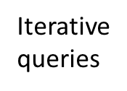



DNS Name Resolution (Port 53 UDP)
Local DNS server
2
Root DNS server
3
4
TLD Domain
5
6
1
8
7
Authoritative DNS server
Recursive
queries
Web server
9

Slide 30
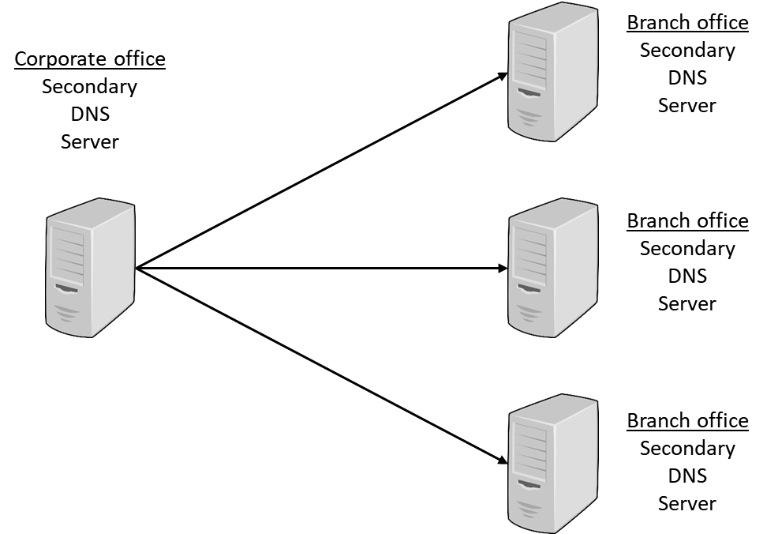
DNS Zone Transfer (Port 53 TCP)

Slide 31
DNS over TCP
DNSSEC (Domain Name System Security Extensions) is a set of extensions to the DNS protocol that, through the use of cryptography, enables origin authentication of DNS data, authenticated denial of existence, and data integrity but does not extend to availability or confidentiality.
DNSSEC records are signed so that all DNSSEC responses are authenticated but not encrypted.
Data transfers over UDP port 53 are limited to 512 bytes in size, and DNSSEC packets can be larger. For this reason, DNSSEC typically uses TCP port 53 for its work. It is possible to extend UDP packet size to 4096 bytes to cope with DNSSEC.

Slide 32
Network Access Control (NAC)
Managing the endpoints on a case-by-case basis as they connect is a security methodology known as network access control (NAC).
Two main competing methodologies exist:
Network Access Protection (NAP) is a Microsoft technology for controlling network access to a computer host
Based on measuring the system health of the connecting machine, including patch levels of the OS, antivirus protection, and system policies.
Network Admission Control (NAC) is Cisco’s technology for controlling network admission.
Built around an appliance that enforces policies chosen by the network administrator.

Slide 33
Agent and Agentless
In agent-based solutions, code is stored on the host machine for activation and use at time of connection.
In agentless solutions, the code resides on the network and is deployed to memory for use in a machine requesting connections, but since it never persists on the host machine, it is referred to as agentless.
Agentless NAC is often implemented in a Microsoft domain through an Active Directory (AD) controller.

Slide 34
Out-of-Band Management
Management of a system across the network can be either in-band or out-of-band.
In in-band management systems, the management channel is the same channel as the data channel.
This has an advantage in physical connection simplicity and a disadvantage that if a problem occurs due to data flows, the management commands may not be able to access the device.
For important network devices and services, an out-of-band management channel is recommended.
Out-of-band management channels are physically separate connections, via separate interfaces that permit the active management of a device even when the data channel is blocked for some reason.

Slide 35
Port Security
Port security is a capability provided by switches that enables you to control which devices and how many of them are allowed to connect via each port on a switch.
Port security operates through the use of MAC addresses.
Port address security based on Media Access Control (MAC) addresses can determine whether a packet is allowed or blocked from a connection.
This is the very function that a firewall uses for its determination, and this same functionality is what allows an 802.1X device to act as an “edge device.”

Slide 36
Port Security
Three variants:
Static learning
A specific MAC address is assigned to a port. This is useful for fixed, dedicated hardware connections.
Dynamic learning
Allows the switch to learn MAC addresses when they connect.
Sticky learning
Also allows multiple devices to a port, but also stores the information in memory that persists through reboots. This prevents the attacker from changing settings through power cycling the switch.

Slide 37
Broadcast Storm Prevention
One form of attack is a flood.
There are numerous types of flooding attacks: ping floods, SYN floods, ICMP floods (Smurf attacks), and traffic flooding.
Flooding attacks are used as a form of denial of service (DoS) to a network or system.
Detecting flooding attacks is relatively easy, but there is a difference between detecting the attack and mitigating the attack.
Flooding can be actively managed through firewalls and IDS/IPS solutions by dropping connections or managing traffic.
Flood guards act by managing traffic flows.
By monitoring the traffic rate and percentage of bandwidth occupied by broadcast, multicast, and unicast traffic, a flood guard can detect when to block traffic to manage flooding.

Slide 38
Bridge Protocol Data Unit (BPDU) Guard
To manage the Spanning Tree Protocol (STP), devices and switches can use Bridge Protocol Data Units (BPDUs) packets.
These are specially crafted messages with frames that contain information about the Spanning Tree Protocol.
The issue with BPDU packets is, while necessary in some circumstances, their use results in a recalculation of the STP, and this consumes resources.
An attacker can issue multiple BPDU packets to a system to force multiple recalculations that serve as a network denial of service attack.
To prevent this form of attack, edge devices can be configured with Bridge Protocol Data Unit (BPDU) guards that detect and drop these packets.
While this eliminates the use of this functionality from some locations, the resultant protection is worth the minor loss of functionality.

Slide 39
Loop Prevention
Switches operate at layer 2 of the OSI reference model, and at this level there is no countdown mechanism to kill packets that get caught in loops or on paths that will never resolve.
This means that a mechanism is needed for loop prevention.
To prevent loops, a technology called spanning trees is employed by virtually all switches.
STP allows for multiple, redundant paths, while breaking loops to ensure a proper broadcast pattern.
STP is a data link layer protocol and is approved in IEEE standards 802.1D, 802.1w, 802.1s, and 802.1Q (VLAN Trunking Protocol).
It acts by trimming connections that are not part of the spanning tree connecting all of the nodes.
STP messages are carried in BPDU frames

Slide 40
Dynamic Host Configuration Protocol (DHCP) Snooping
Under DHCP, when a system boots up or is connected to the network, it sends out a broadcast query looking for a DHCP server.
All available DHCP servers reply to this request.
Should there be more than one active DHCP server within the network, the client uses the one whose answer reaches them first.
From this DHCP server, the client then receives the address assignment.

Slide 41
Dynamic Host Configuration Protocol (DHCP) Snooping
The weakness of using the first response received allows a rogue DNS server to reconfigure the network.
A rogue DHCP server can route the client to a different gateway, an attack known as DHCP spoofing.
Attackers can use a fake gateway to record data transfers, obtaining sensitive information, before sending data on to its intended destination, which is known as a man-in-the-middle attack.
Dynamic Host Configuration Protocol (DHCP) snooping is a defensive measure against an attacker that attempts to use a rogue DHCP device.
DHCP snooping prevents malicious DHCP servers from establishing contact by examining DHCP responses at the switch level and not sending those from unauthorized DHCP servers.

Slide 42
Media Access Control (MAC) Filtering
MAC filtering is the selective admission of packets based on a list of approved Media Access Control (MAC) addresses.
Employed on switches, this method is used to provide a means of machine authentication.
In wired networks, this enjoys the protection afforded by the wires, making interception of signals to determine their MAC addresses difficult.
In wireless networks, this same mechanism suffers from the fact that an attacker can see the MAC addresses of all traffic to and from the access point, and then can spoof the MAC addresses that are permitted to communicate via the access point.

Slide 43
Network Appliances
Network appliances are machines that provide services across a network.
Many network-based functionalities can be effectively managed via network appliances.
Security functions such as jump servers, network-based intrusion detection systems, VPN endpoints, collectors, and aggregators are some common examples.
The next sections contain information on those specifically identified in Security+ objectives.

Slide 44
Jump Servers
A jump server is a hardened system on a network specifically used to access devices in a separate security zone.
For someone outside the network to access protected resources inside the network, they first connect to the jump host, and their activities to the internal services are performed via that connection.
Because of specific monitoring and hardening, a jump server can act as a safer alternative than allowing direct outside access.
The level of functionality via a jump host can be controlled, and the activity can be specifically monitored to detect and stop attacks.

Slide 45
Proxy Servers
Proxy server can be used to filter out undesirable traffic and prevent employees from accessing potentially hostile websites.
A proxy server takes requests from a client system and forwards them to the destination server on behalf of the client.
Deploying a proxy solution within a network environment is usually done either by setting up the proxy and requiring all client systems to configure their browsers to use the proxy or by deploying an intercepting proxy that actively intercepts all requests without requiring client-side configuration.
Proxies are most useful in their ability to control and filter outbound requests.
Administrators also use proxies to enforce corporate acceptable use policies and track use of corporate resources.

Slide 46
Proxy Servers
Different types of proxies:
Forward
A forward proxy operates to forward requests to servers based on a variety of parameters
Forward proxies can be used to bypass firewall restrictions, act as a cache server, and change your IP address (more useful before widespread adoption of NAT).
Forward proxies can be deployed by attackers to get users to use them for “caching purposes” under the guise of speeding up connections, when, in fact, they actually slow down the connection and create a man-in-the-middle attack scenario.
Reverse
A reverse proxy is typically installed on the server side of a network connection, often in front of a group of web servers, and intercepts all incoming web requests.
It can perform a number of functions, including traffic filtering, Secure Sockets Layer (SSL)/Transport Layer Security (TLS) decryption, serving of common static content such as graphics, and performing load balancing.

Slide 47
Network-based Intrusion Detection System (NIDS)/Network-based Intrusion Prevention System (NIPS)
Network-based intrusion detection systems (NIDSs) are designed to detect, log, and respond to unauthorized network or host use, both in real time and after the fact.
A network-based intrusion prevention system (NIPS) has as its core an intrusion detection system.
A NIPS can take direct action to block an attack, with its actions governed by rules. By automating the response, a NIPS significantly shortens the response time between detection and action.

Slide 48
Network-based Intrusion Detection System (NIDS)/Network-based Intrusion Prevention System (NIPS)
Whether network-based or host-based, an IDS will typically consist of several specialized components working together.
Traffic collector (sensor)
This component collects activity/events for the IDS to examine.
Analysis engine
This component examines the collected network traffic and compares it to known patterns of suspicious or malicious activity stored in the signature database.
Signature database
The signature database is a collection of patterns and definitions of known suspicious or malicious activity.
User interface and reporting
This component interfaces with the human element, providing alerts when appropriate and giving the user a means to interact with and operate the IDS.

Slide 49
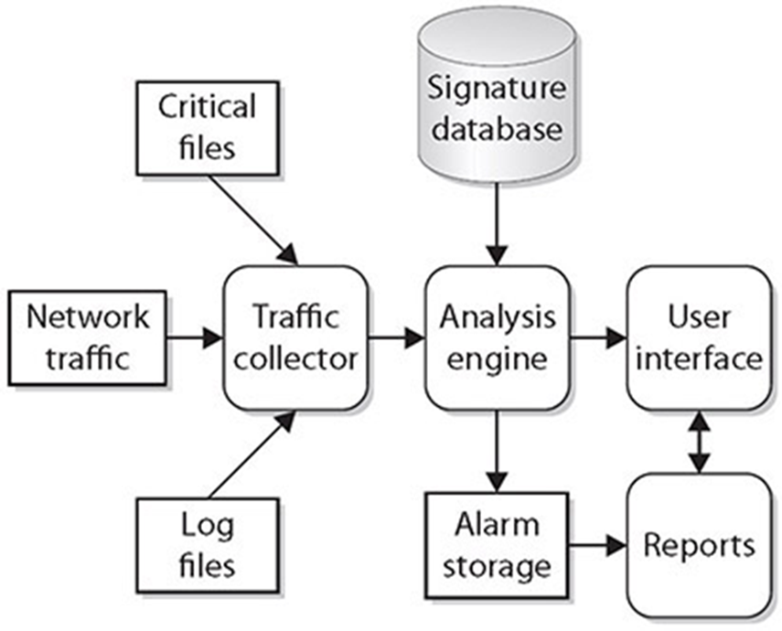
Network-based Intrusion Detection System (NIDS)/Network-based Intrusion Prevention System (NIPS)

Slide 50
Network-based Intrusion Detection System (NIDS)/Network-based Intrusion Prevention System (NIPS)
NIDSs/NIPSs can be divided into three categories based on primary methods of detection used:
Signature Based
Relies on a predefined set of patterns (called signatures).
Heuristic/Behavior
The behavioral model relies on a collected set of “normal behavior”—what should happen on the network and is considered “normal” or “acceptable” traffic.
Anomaly
This detection model is similar to behavior-based methods.
An anomaly is a deviation from an expected pattern or behavior.

Slide 51
Network-based Intrusion Detection System (NIDS)/Network-based Intrusion Prevention System (NIPS)
An in-band NIDS/NIPS is an inline sensor coupled to a NIDS/NIPS that makes its decisions “in band” and enacts changes via the sensor. This has the advantage of high security, but it also has implications related to traffic levels and traffic complexity. In-band solutions work great for protecting network segments that have high-value systems and a limited number of traffic types, such as in front of a set of database servers with serious corporate data, where the only types of access would be via database connections.
An out-of-band system relies on a passive sensor, or set of passive sensors, and has the advantage of greater flexibility in detection across a wider range of traffic types. The disadvantage is the delay in reacting to the positive findings, as the traffic has already passed to the end host.

Slide 52
HSM
A Hardware Security Module (HSM) is a device used to manage or store encryption keys. It can also assist in cryptographic operations such as encryption, hashing, or the application of digital signatures.
HSMs are typically peripheral devices, connected via USB or a network connection.
HSMs have tamper-protection mechanisms to prevent physical access to the secrets they safeguard.
Because of their dedicated design, they can offer significant performance advantages over general-purpose computers when it comes to cryptographic operations.
When an enterprise has significant levels of cryptographic operations, HSMs can provide throughput efficiencies.
Examples: KG-175D, KG-250

Slide 53
Sensors
Sensors are devices that capture data and act upon it.
There are multiple kinds of sensors and various placement scenarios.
Each type of sensor is different, and no single type of sensor can sense everything.
Sensors can be divided into two types based on where they are placed: network and host.
Sensors have several different actions they can take they can report on what they observe, they can use multiple readings to match a pattern and create an event, and they can act based on proscribed rules.
Not all sensors can take all actions, and the application of specific sensors is part of a monitoring and control deployment strategy.

Slide 54
Collectors
Collectors are sensors, or concentrators that combine multiple sensors, that collect data for processing by other systems.
Collectors are subject to the same placement rules and limitations as sensors.

Slide 55
Aggregators
An aggregator is a device that takes multiple inputs and combines them to a single output.
Think of it as a many-to-one type of device.
It is placed upstream from the multitude of devices and can take the place of a router or a much larger switch.
Example: Aggregation switch

Slide 56
Firewalls
A firewall can be hardware, software, or a combination of both whose purpose is to enforce a set of network security policies across network connections.
The heart of a firewall is the set of security policies that it enforces.
Management determines what is allowed in the form of network traffic between devices, and these policies are used to build rulesets for the firewall devices used to filter network traffic across the network.
Security policies are rules that define what traffic is permissible and what traffic is to be blocked or denied.
A key to setting security policies for firewalls is the same as for other security policies—the principle of least access: allow only the necessary access for a function; block or deny all unneeded functionality.

Slide 57
Firewalls
At a minimum, your organization’s connection to the Internet should pass through a firewall.
This firewall should block all network traffic except that specifically authorized by the organization.
Blocking communications on a port is simple—just tell the firewall to close the port.
The issue comes in deciding what services are needed and by whom, and thus which ports should be open, and which should be closed.
This is what makes a security policy useful. The perfect set of network security policies, for a firewall, is one that the end user never sees and that never allows even a single unauthorized packet to enter the network.

Slide 58
Firewalls
To develop a complete and comprehensive security policy, you first need to have a complete and comprehensive understanding of your network resources and their uses.
Firewalls are designed to block attacks before they reach a target machine.
Common targets are web servers, e-mail servers, DNS servers, FTP services, and databases.

Slide 59
Firewalls
Types of firewalls:
Web Application Firewall (WAF)
NGFW
Stateful vs Stateless
Unified Threat Management
Network Address Translation (NAT) Gateway
Content/URL filter
Open Source vs. Proprietary
Hardware vs. Software
Appliance vs. Host Based vs. Virtual

Slide 60
Access Control List (ACL)
Access Controls Lists provide the system information as to what objects are permitted which actions.
In the case of networks, ACLs can control who gets to change the network parameters via configurations, who gets to pass specific firewalls, and a host of other decisions.
The concept of having a list of allowed users, or ACL, is widely used by networks to manage the network security aspects.

Slide 61
Route Security
Routing is the basis of interconnecting networks that comprise the Internet.
Packets cross the networks to move information from source to destination.
Depending on where the source and destination are with respect to each other, the route a packet takes can be wide ranging, from simple and short to complex and long.
The protocols used to connect the various networks range from simple, like the Internet Protocol (IP), to more complex, such as BGP, IS-IS, OSPF, EIGRP, and RIPv2.
Maintaining route security is part of the function of each of these protocols, and each serves to fulfill a specific needed functionality in connecting networks.

Slide 62
Quality of Service (QoS)
Quality of Service (QoS) is the use of specific technologies on a network to guarantee its ability to manage traffic based on a variety of indicators.
High-bandwidth, real-time traffic, such as Voice over IP (VoIP), video conferencing, and video-on-demand, has a high sensitivity to network issues such as latency and jitter.
QoS technologies are used to manage network conditions such as bandwidth (throughput), latency (delay), jitter (variance in latency), and error rates.
They do this by providing differentiated handling and capacity allocation to specific flows based on packet type and source.
QoS enables network administrators to assign the priority in which packets are handled as well as the amount of bandwidth afforded to that application or traffic flow.

Slide 63
Implications of IPv6
128-bit hexadecimal address
IPv6 enables end-to-end encryption, which is great for communication security but bad for network monitoring.
IPv6 uses the Secure Neighbor Discovery (SEND) protocol, which alleviates ARP poisoning attacks.
NAT not necessary in IPv6

Slide 64
Port Spanning/Port Mirroring
Most enterprise switches have the ability to copy the activity of one or more ports through a Switch Port Analyzer (SPAN) port, also known as a port mirror.
This traffic can then be sent to a device for analysis. Port mirrors can have issues when traffic levels get heavy, as the aggregate SPAN traffic can exceed the throughput of the device.
For example, a 16-port switch, with each port running at 100 Mbps, can have traffic levels of 1.6 GB if all circuits are maxed, which gives you a good idea of why this technology can have issues in high-traffic environments.

Slide 65
Port Taps
A Test Access Point (TAP) is a passive signal-copying mechanism installed between two points on the network.
The TAP can copy all packets it receives, rebuilding a copy of all messages.
TAPs provide the one distinct advantage of not being overwhelmed by traffic levels, at least not in the process of data collection.
The primary disadvantage is that a TAP is a separate piece of hardware and adds to network costs.
Unauthorized TAPs can present a security threat, as they make a connection available for monitoring and altering traffic as a man-in-the-middle attack.

Slide 66
Monitoring Services
Network Security Monitoring (NSM) is the process of collecting and analyzing network data to detect unauthorized activity.
NSM is not a way to prevent intrusions, but when deployed inside a network, it can detect where other defenses have failed.
It is like having a local security guard patrolling inside a closed building.
NSM can be deployed as a service, and many firms have an offering to support monitoring services that give an enterprise a means of detecting unauthorized activity.

Slide 67
File Integrity Monitors
File integrity monitors are a series of internal processes that can validate the integrity of OS and application files.
There are OS utilities that can be automated to do this as well as applications to manage this critical task.
Some forms of whitelisting solutions perform this same task, doing a hash check against a known-good value before allowing a program to launch.
File integrity checks operate by taking a hash of the file and comparing this value to an offline store of correct values. If the hashes match, then the file is unaltered.

